Slide 1
Coronavirus and
Care Homes:
What happened and why?
Mary Daly
Professor of Sociology and Social Policy
& Governing Body Fellow, Green Templeton College
21 May 2020

Slide 2
Thinking About Where We Are
Latest statistics (announced by May 15th last):
12,526 care home residents’ deaths attributed to Covid-19 in England and Wales (between March 2nd and May 9th)
14,835 (very latest figure – came out on Tuesday, May 19th)
In the most recent week, of all Covid-19 deaths care homes = 41.7% ; hospitals = 52.8%
Mortality of care home residents - up by some 50% in England and Wales in first 4 months of 2020
Care workers too have a higher risk of death from Covid-19 – in fact in England and Wales they are twice as likely to die from Covid-19 as the general working age population
My talk is in two main parts:
What happened (in terms of policy approach and timeline)?
Why? – offering a multi-faceted explanation that goes beyond logistics and resources

Slide 3
How Should We Assess Policy?
4 Lines of Investigation
Were care homes the target of a specific policy or action plan?
Was monitoring available to care homes?
What staffing and workforce support was (put) in place?
Was additional funding made available?
The ‘what’ has to be combined with the ‘when’ – timeline is very important
Some clarifications
Care homes = care and accommodation provided in collective setting
Speaking of England mainly
The policy field is ‘adult social care’
Very different to health (under NHS)

Slide 4
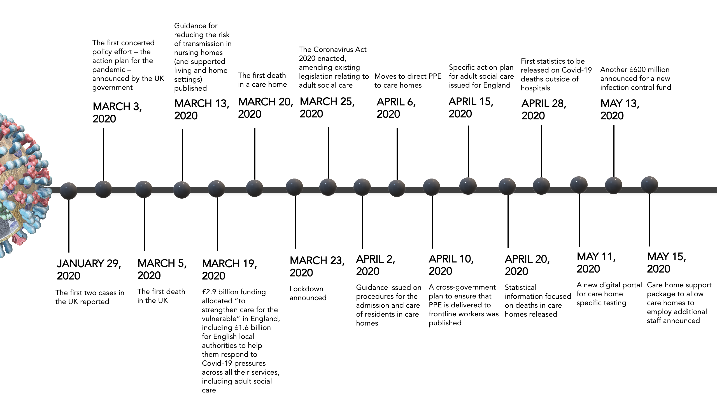

Slide 5

1. Action Plan
March 3rd
General action plan
April 15th
Action plan for adult social care
May 15th
A specific care home support package
6 weeks later → →
Another month later → →

Slide 6
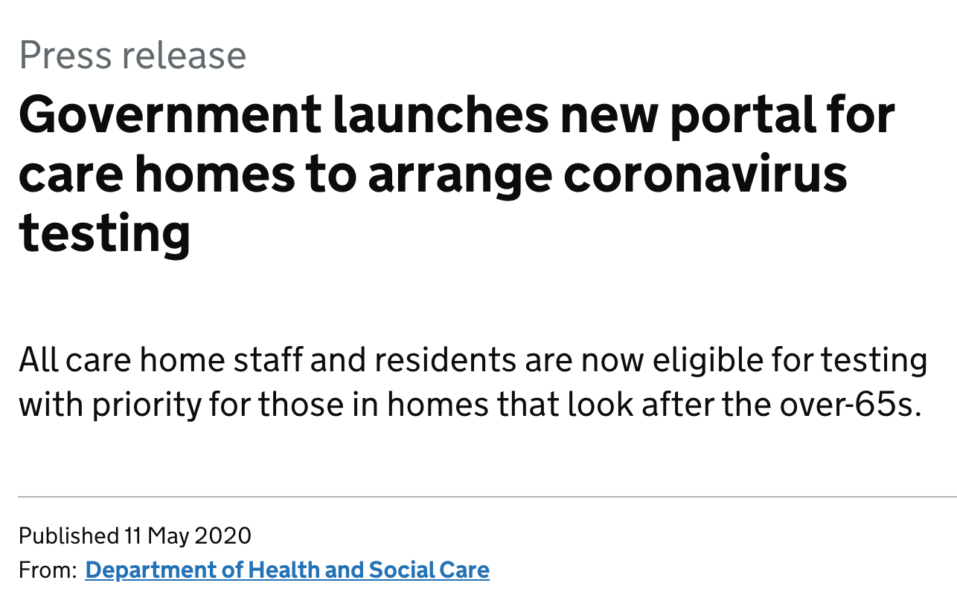
2. Monitoring
TESTING:
Late March
Ambitious testing regime for NHS staff first
April 15th
Testing would be offered to everyone needing it in social care settings
May 11th
A new digital portal for care home specific testing announced
2 weeks later → →
4 weeks
later
→ →
COUNTING MORTALITY:
March 5th
First death recorded in the UK
April 20th
Inclusion of Covid-19 deaths in care homes in the statistics
6 weeks later → →

Slide 7
3. Staffing and Working Conditions
PPE:
April 2nd
PPE – for NHS detailed supply plan
April 6th
A supply chain that included care homes
April 10th
Plan to deliver PPE to ‘frontline workers’ and guidance published
May 15th
Specific Guidance for Care Homes
New route
→ →
→ →
→ →
Staffing:
March 24th
Plans to add 35,000 NHS staff
April 15th
Ambitions to attract an additional 20,000 workers to the adult social care sector
→ → → →

Slide 8
4. Funding
Additional relevant funding to local authorities – some £3.2 billion since early March
Plus an additional £1.3 billion for enhancing hospital discharge procedures
First tranche of funding of March 19th was for ‘care for the vulnerable’; similarly the second tranche (announced on April 18th) was also generic, little targeting of care for older people, little specific targeting of care homes
A targeted package for care homes announced on May 13th-15th May - £600 million for infection control fund and a support package (for staffing and clinical support inter alia)
£3.2billion

Slide 9
What Might Have Been Aimed For?
Prevention
Measures to support care homes in preparing and dealing with outbreaks | hardly
Measures to prevent Covid-19 infections from entering a care home | hardly
Measures to monitor potential infections | hardly
Control
Measures to control the infection once it has entered the facility | only partly
Measures to ensure access to health care for residents with Covid-19 | hardly
Measures to manage staff availability and wellbeing | only partly
Measures to compensate for the impact of physical distancing and other challenges in care homes | only partly/hardly
OVERALL RESPONSE: Inadequate, slow, reactive and too late

Slide 10
Potential Options/Measures (from other countries)?
(with measures like PPE and testing and contact tracing assumed to be normal)
A national or regional (or local) task force - Austria, Israel, Italy
(and at the minimum an earlier SAGE subgroup on Covid-19 in care homes)
Measures to enable better collaboration among care homes (through data sharing and integrated IT systems for example) - China
Rapid response teams to support care homes coping with elevated risks (as well as social distancing, self isolation challenges) – Bavaria, Slovenia
Increased pay and/or bonuses for care home workers - Scotland
Redeployment of staff from medical to care home settings - Slovenia
Measures to reduce care home occupancy – Austria, Slovenia
See https://ltccovid.org/

Slide 11
How Do We Explain What Happened?
A complex of factors:
Logistical and sectoral complexity
Impact of austerity and funding cuts
Place of social care vis-à-vis health in public opinion and in hearts and minds

Slide 12
Logistical problems (1)
Divide between health and social care – essentially 2 systems
Co-ordination/integration attempts have been made – 12 white papers, green papers and consultations, and five independent reviews/consultations
Under current plans all parts of the NHS in England are meant to have created an integrated care system by April 2021 – requiring the dilution or destruction of the long-standing barriers between hospitals, GP practices, community services and social care
However progress is slow, despite some positive developments
Pandemic meets - the NHS and social care as separate funding/resourcing, governance, legislative, staffing, service and provisioning regimes

Slide 13
Logistical problems (2)
Complex structure of adult social care system – including complex funding structure that leaves different councils and their local areas differentially resourced
+ Complex care provision sector
11,000 care homes for over 65s in England, operated by 5,000 different providers
All except about 5% are private sector
Great variation in scale but many (80%) small and lone establishment
Variation in needs being met – 40% specialist dementia care
Pandemic meets – a complex, largely privatised and poorly-co-ordinated sector

Slide 14
Funding/austerity
Central government funding to local authorities down by an estimated 50% in real terms up to this year from 2009/2010
Adult social care protected from cuts by local authorities to some extent
Freezing fees (especially in first 5 years of austerity) – this affected operating resources + stripped significant quality from the sector
Set in train other changes that incentivize profit making (upping scale)
Highly volatile staffing – problems of recruitment and retention, agency working and movement from job to job
Rising unmet need and public dissatisfaction
Pandemic meets – a weakened, under-resourced sector on ‘life support’

Slide 15


Cultural factors
NHS a towering presence enjoying generally very wide support
A clear brand with strong public support
Messaged by the government as in need of protection
Well organised with strong unions/professional associations
Social care in contrast:
No brand or clear identity
Public generally uninformed and ambivalent
No authoritative/single voice
Little organisation of the sector as a whole
Pandemic meets – an undervalued, largely hidden and misunderstood sector

Slide 16
Overall Story
A pandemic meets:
A complex and diverse but fragmented nursing/care home set up and supply and delivery route
In a weakly governed and under-resourced sector, especially affected by austerity
Located in the adult social care field which is itself a sector long in need of reform and in which policy change has been sluggish/frozen
In a context where the NHS consumes most of the oxygen and resources and enjoys superior political and cultural capital
So a very complicated set of challenges!

Slide 17
Positive takeaways
Greater working together at local level
New procedures – better use of digital procedures (e.g., capacity tracker for beds, staffing)
More visibility for care homes and those involved
Greater recognition for care – e.g., Care Badge
Better data gathering and knowledge of the care home population
Elevated volunteer capacity

Slide 18
Some ‘Tests’ to See
Whether a Deeper Change is Underway
Short-term
The treatment of care workers in the Immigration Bill
An enquiry into policy on Covid-19 and care homes
Support to address the trauma and grief around what happened
More long-term
Better and more regulated conditions of work in the sector
Increased generosity of the funding for the purpose of strengthening the long-term care system and especially reducing the reliance on temporary or special funding (long-term ring-fenced funding like the NHS)
A joined up system of regulation and support of care homes
A more joined up health-care system and national and local government
Better facilitating community living for older people

Slide 19
Sticking Points in Reform
Making the necessary funding available (£1.5 billion)
Deciding on rights/entitlements and responsibilities
Deciding on the share and nature of public versus/private components
Proposals include: fully funded domiciliary care
Higher means-test threshold to enter the system
Cap on lifetime contribution
A national care service

