Slide 1

Long-term care and climate change:
Preparing to respond to climate change, building on lessons from the COVID-19 pandemic
Adelina Comas-Herrera
Director, Global Observatory of Long-Term Care
Care Policy and Evaluation Centre
London School of Economics and Political Science
www.goltc.org

Slide 2
What is Long-Term Care?
The activities carried out by others to ensure that people with, or at risk, of a significant loss of intrinsic capacity can maintain a level of functional ability consistent with their basic rights, fundamental freedoms and human dignity
WHO (2015) World Report on Ageing and Health. WHO, Geneva

Slide 3
What does LTC involve in practice?
Aims to:
reduce, lessen consequences of, or compensate for disability, cognitive impairment and loneliness; improve quality of life
support family and other unpaid carers
Services are delivered in:
People’s own homes (home help, meals, nursing care) and in the community
or in substitute care settings (residential care homes, nursing homes, hospitals)
Support is provided by:
Unpaid carers (mostly family but also community)
Formal care providers (public, private and voluntary sector), usually low levels of training
Type of activities:
Support with everyday tasks, including dressing, bathing, shopping, cooking, cleaning, therapy, social participation

Slide 4











The experience of Long-Term Care: a personal ecosystem in the local environment and complex systems
Other factors: macroeconomic situation, pension system, labour, migration, housing policies, mechanisms to guarantee the rights of people with disabilities, security and climate threats, etc.
.
Health system: quality of primary care and person-centeredness
LTC system: generosity, quality, orientation towards the person and the community
Resilience, personal situation and characteristics
Care and support from familty members: big differences in availability and impacts
Quality, accesibility and friendliness of the environment
Community, volunteers
Housing: accesibility and quality

Slide 5
“Traditional” approaches to Long-Term Care:
Provided almost entirely by families, public sector/charity stepping in when other care not available (poverty/no family):
  Care mostly provided by women
  Social services only for destitute people without family support
  Long-stay hospital geriatric wards
  Perhaps some support from primary care/community health
Private care for very wealthy people (often unregulated domestic workers)
Institutionalised residential care facilities, often unregulated

Slide 6
Demographic, epidemiological, social and economic shifts are putting “traditional care” models under strain
Larger number of people living to older ages
Fewer numbers of people of traditional “working age”
Changes in roles of women and labour markets
Changes in expectations about how we want to live as we grow older
Larger number of people ageing with dementia and complex health needs
Lack of formal care is a barrier to (particularly) women’s labour force participation and may condemn them to poverty in old age
Lack of formal care has been found to lead to avoidable (and expensive) hospitalisations
  While difficult to quantify, growing evidence of fiscal and direct economic costs of not investing in public LTC systems

Slide 7
LTC systems pre-pandemic: still work in progress even in high-income countries
“There is a history in many countries of LTC policies being developed in a piecemeal manner, responding to immediate political or financial problems, rather than being constructed in a sustainable, transparent manner. The future of LTC is more demand, more spending, more workers… Facing up to this challenge requires a comprehensive vision of long-term care. Muddling through is not good enough”
(OECD, 2011 Help Wanted?)

Slide 8
Long-Term Care and the Covid-19 pandemic

Slide 9
A disproportionate impact
At the beginning of the pandemic nearly 50% of all COVID-19 deaths were among care home residents, this share reduced over time
Population in care homes represents 0.75% of all population in those countries
Age and underlying health conditions alone do not explain this magnitude of impact
Some potential explanations:
  Difficulty (or even impossibility?) of implementing physical distancing in care homes
  Late / insufficient access to testing and PPE
  Late adaptation of guidance to recognize “geriatric COVID symptoms” and asymptomatic transmission
  Reduced access to healthcare
  In some countries, late access to vaccination for people in care homes
Not much data available on impacts on people receiving and providing care at home

Slide 10
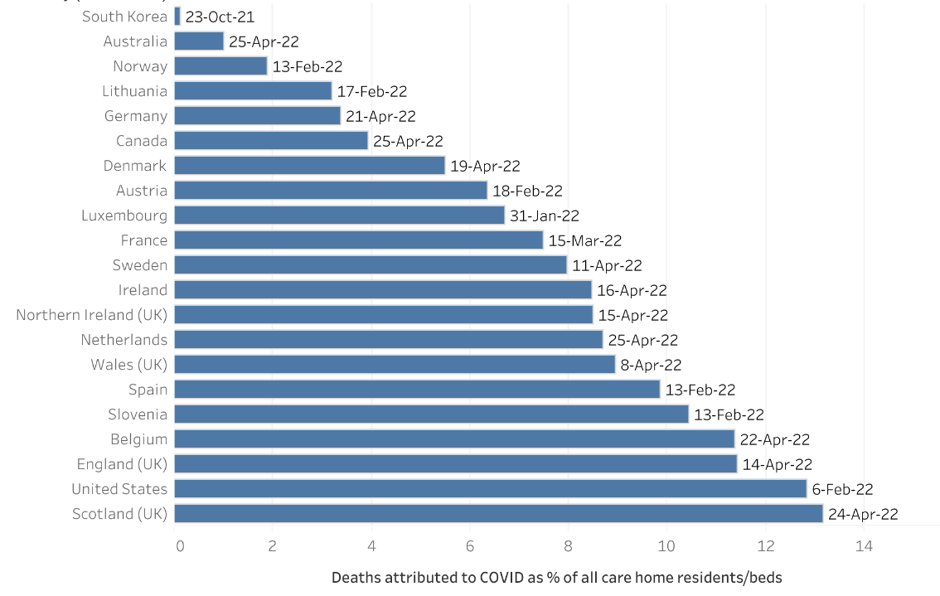
Share of care home residents whose deaths were linked to Covid-19, compared to care home population (April 2022)
Source: https://ltccovid.org/2022/02/22/international-data-on-deaths-attributed-to-covid-19-among-people-living-in-care-homes/

Slide 11
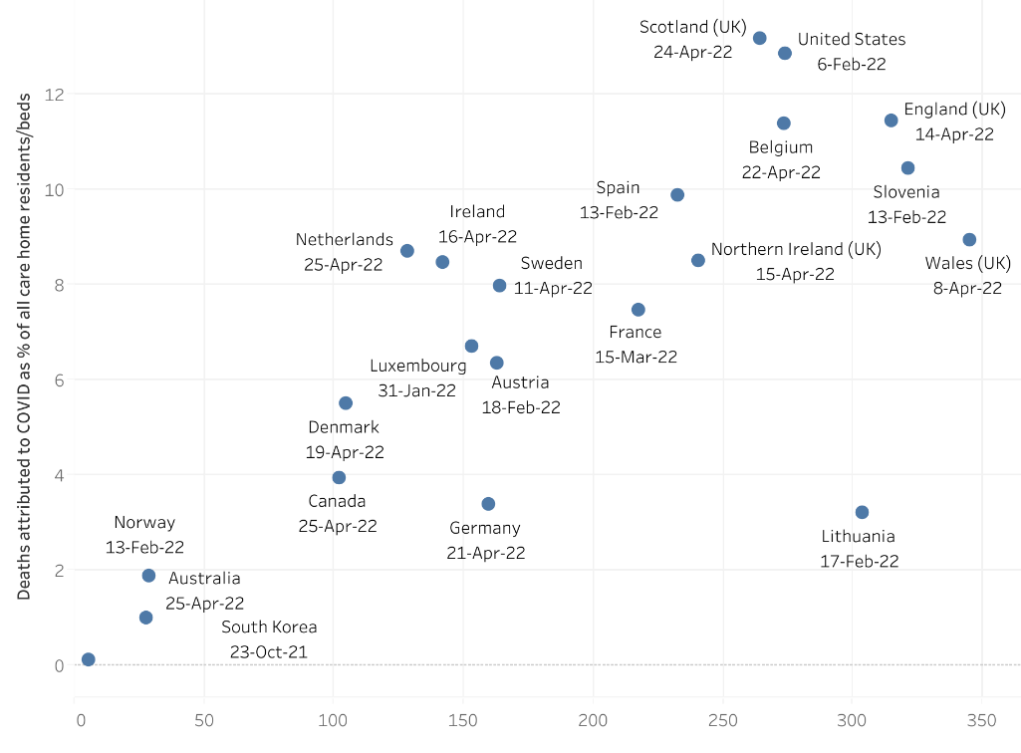
Total number of deaths linked to Covid-19 in the population living in the community, compared to deaths of care home residents (April 2022)
Source: https://ltccovid.org/2022/02/22/international-data-on-deaths-attributed-to-covid-19-among-people-living-in-care-homes/

Slide 12
What have we learnt from international Covid-19 mortality data in care homes?
Focussing on % of deaths that happens in care homes is only useful to show the scale of the problem
To compare impacts in countries, shares of total care homes residents who died offers a different perspective on the differences of impact of COVID-19 on care home residents
Mortality data does not convey the enormity of other impacts, for which there is increasing evidence
  Impact on wellbeing, mental health, cognitive and behavioural symptoms
  Increased prescription of anti-psychotics
  Decreased access to diagnostic services and other care
  Enormous impacts on unpaid and unpaid carers as well

Slide 13
There were common structural challenges behind international responses to COVID-19 in LTC
Low political priority for LTC (compared to acute health care & other policy areas)
Fragmented systems, responsibilities split between different government departments and levels of government (local/regional/national): no one was in charge
Failures in health/LTC coordination resulting in limited access to health care
Weak regulatory oversight and inexistent or underdeveloped information systems
Lack of recognition of human rights of people living in care homes
Under-recognition of care staff: low pay/staff shortages/poor working conditions
Under-investment in community-based care/ outdated buildings used as LTC facilities
https://ltccovid.org/international-living-report-covid-ltc/

Slide 14
Social Care in England and the Covid pandemic
Curry N, Oung C, Hemmings N, Comas-Herrera A and Byrd W (2023) Building a resilient social care system in England: What lessons can be learnt from Covid-19? Research report, Nuffield Trust and Care Policy and Evaluation Centre.
https://www.nuffieldtrust.org.uk/research/building-a-resilient-social-care-system-in-england-what-lessons-can-be-learnt-from-covid-19

Slide 15

Underlying structural CHALLENGES
Covid highlighted & exacerbated underlying structural challenges:
    Cuts to social care spending over time
    High levels of unmet need
    Limited investment & innovation
    Fragile provider market
    Workforce shortages, terms & conditions, and training
    Limited and variable integration between health & social care
    Limited reliable data on the sector
“those breakdowns were absolutely fundamentally there before that and yet nobody was taking responsibility for it… the crisis was precipitated by that”
“I think if you were designing a structure which was fit for pandemic response you would not have designed the social care sector that you had”
“could we have predicted where the weaknesses would have been in any crisis…probably, because they were pre-existing”

Slide 16
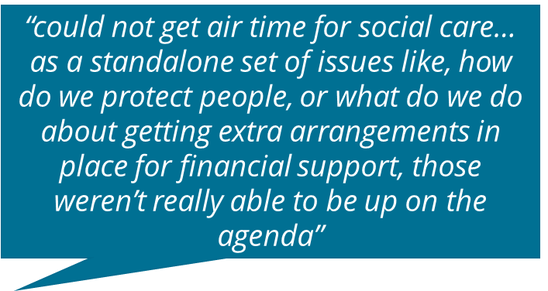
Covid response
Documents & interviews point to:
National response: action plan published 15 April
Low visibility: adjunct to the NHS with too little consideration of the fragility & complexity of the sector
Limited of coordination re PPE & testing at first
Stretched capacity and operational knowledge of social care among key decisionmakers in central government
Complex accountability & communications mechanisms
“There was a lot of ambition to get testing in place for social care… but we weren’t able to make headway, because… a wave was already washing through the system”
“it is very rarely clear in social care who is responsible for what bit… even where the accountability was clear, it still might not have been right”

Slide 17
Preparedness
Missed opportunities for better preparedness in wave one:
    Learning from China in the early stages re population groups most affected
    Experiences of care homes in Italy, Spain & USA
    Exercise Cygnus (2016)
Some lessons learnt & implemented in wave 2:
    Taskforce recommendations
    Winter plan & specific proactive financial support to the sector
    Testing speed & spread accelerated
    Vaccine roll out
    Capacity at the centre expanded
    Positives to embed around use of technology & willingness to gather & share data
“I think the networks were better, the communications were better, things were being co-produced with the sector at an earlier date… but it still felt quite short-term, quite reactive rather than feeling very planned and we knew what was coming, when”
“we’ve had a huge social experiment over the last year, which is to share with one another the names of vulnerable people… we never knew them, and now we know them, so there’s potential for a prevention approach”

Slide 18
Some potential positives overall?
Increased public and political awareness about Long-Term Care (at least initially)
Improvements in data and information systems
Good examples of how well-established care coordination mechanisms worked
Some innovative care approaches (Care ecosystems, smaller care homes) worked better
Increased uses of technology
Increased research focus on LTC: learning beyond COVID
International lesson sharing

Slide 19
Long-Term Care and Climate Change
Older adults and people with chronic illnesses and disabilities face increased exposures to climate-related hazards
Climate change intersects with other ongoing crises:
  Rise in prevalence of multimorbidity
  Rising social inequality
  Chronic underinvestment in care systems

Slide 20





In collaboration with
Andrea Schmidt, Klara Lorenz-Dant, Liat Ayalon and David Palomera

Slide 21
We ask:
What are the parallels between the climate crisis and the Covid-19 pandemic?
Can lessons learnt from the pandemic inform climate adaptation strategies to ensure future responses are preventative and just?

Slide 22
Climate related hazards and exposure pathways relevant to people who use LTC services
Extreme temperatures
Wildfires
Droughts
Flooding
Storms and sea level rise
Air quality
Climate-sensitive infectious diseases
Food and water insecurities
Migration and relocation
Prina et al. 2024 https://jogh.org/2024/jogh-14-04101

Slide 23
Vulnerability
Defined as the susceptibility to change or harm
  In relation to climate change: function of exposure, sensitivity and adaptive capacity
  Exposure is a measurement of the extent, duration, or frequency of stress on a system; it is essential to understanding a population’s vulnerability to climate change
  Sensitivity is defined as the degree to which a system or species is affected, either adversely or beneficially, by climate variability or change
  Adaptive capacity is the ability of a system (or population) to cope with actual or expected stress
Wollschlaeger et al., 2022 https://doi.org/10.1016/j.cacint.2021.100077

Slide 24
Exposure
Built environment: quality and location of the buildings in which older people live (own homes or care facilities)
  Thermal properties of buildings: care needs associated with poverty, means more likely to live in poor quality housing, also outdated buildings frequently used as care homes
  People with disabilities more likely to live in ground floors: higher flooding risk
Personal care requires close proximity, increased exposure to infectious diseases

Slide 25
Sensitivity
Growing evidence showing that older adults and people with disabilities have higher sensitivity to extreme temperatures, compromised immune systems, pre-existing medical conditions, functional, cognitive impairments
  E.g. Nursing Home in British Columbia: 97% of residents had chronic conditions, including some that exacerbate with increased heat (hypertension, dementia)
Wollschlaeger et al., 2022 https://doi.org/10.1016/j.cacint.2021.100077
Prina et al., 2024 https://jogh.org/2024/jogh-14-04101

Slide 26
Adaptive capacity
Needing care and support puts people at greater risk in extreme climate events and epidemics:
Strongest risk factors for dying in a heat wave are being confined to a bed and living alone
During evacuations, people living in LTC facilities are most likely to die
Dependence on others to get out of harm’s way due to physical and cognitive impairments
Need for physical contact for most personal care makes distancing impossible, making “distancing measures” unviable
Ageism and ableism may de-prioritise those most vulnerable from the emergency response
Valencia 2024 floods:
Nearly half (104 out of 216) of all the people who died were aged 70 and over (they represented 15% of the population), partly attributed to older people who have mobility problems living on the ground floor
Japan:
6 months after flooding, people receiving LTC at home 3 times more likely to have moved to a nursing home, compared to people with similar characteristics not affected by the flooding (Miyamori et al., 2023).

Slide 27
Building resilient care systems

Slide 28
Care services need to be resilient in crisis
Climate change highlights vulnerabilities within LTC systems in the face of extreme weather events:
Importance of home/community-based care to ensure safety and wellbeing of people who are socially isolated or who need care and support.
Ensure there is enough workforce and is well-trained to respond
Ensuring buildings are adequate in terms of quality and location (both private homes and residential care facilities) and built/retrofitted to be climate resilient and designed to facilitate quality of life
Information systems to support real-time risk assessment and prioritisation in emergencies, need to cover formal and “informal” care systems
Assessment of longer-term impacts of crises on people with care needs

Slide 29



Buildings and facilities: lessons from Covid
Regulatory measures and investment can bring about high standards in social care facilities. This can promote choice and wellbeing and strengthen resilience to infectious outbreaks.
Examples:
Denmark: since 1984 it is illegal to construct multiple bed care homes. All new build care homes are private rooms with personal space (bathroom, kitchenette, living space, often also outdoor space). People who live there pay rent and the care system pays for the care services and those who want to live with their spouse must be given accommodation suitable for two people.
During the pandemic this care home design facilitated the implementation of IPC measures, e.g. easier to implement isolation and cohorting (particularly where there was an outdoor entrance), and to maintain family contacts.
Japan: moving towards single use rooms with toilets and showers, and outside access (via veranda). Outside access supports emergency preparedness e.g. for earthquakes.
French reforms introduced in Summer 2020 included €1.5 billion euros over 4 years to transform residential and nursing home models, with an additional €125 million to improve building stock.
Curry N, Oung C, Comas-Herrera A and Marczak J (2025) Building resilience in adult social care: Learning the lessons from other countries’ experiences of Covid-19. Research summary, Nuffield Trust and LSE Care Policy and Evaluation Centre. https://www.nuffieldtrust.org.uk/research/building-resilience-in-adult-social-care-learning-the-lessons-from-other-countries-experiences-of-covid-19

Slide 30
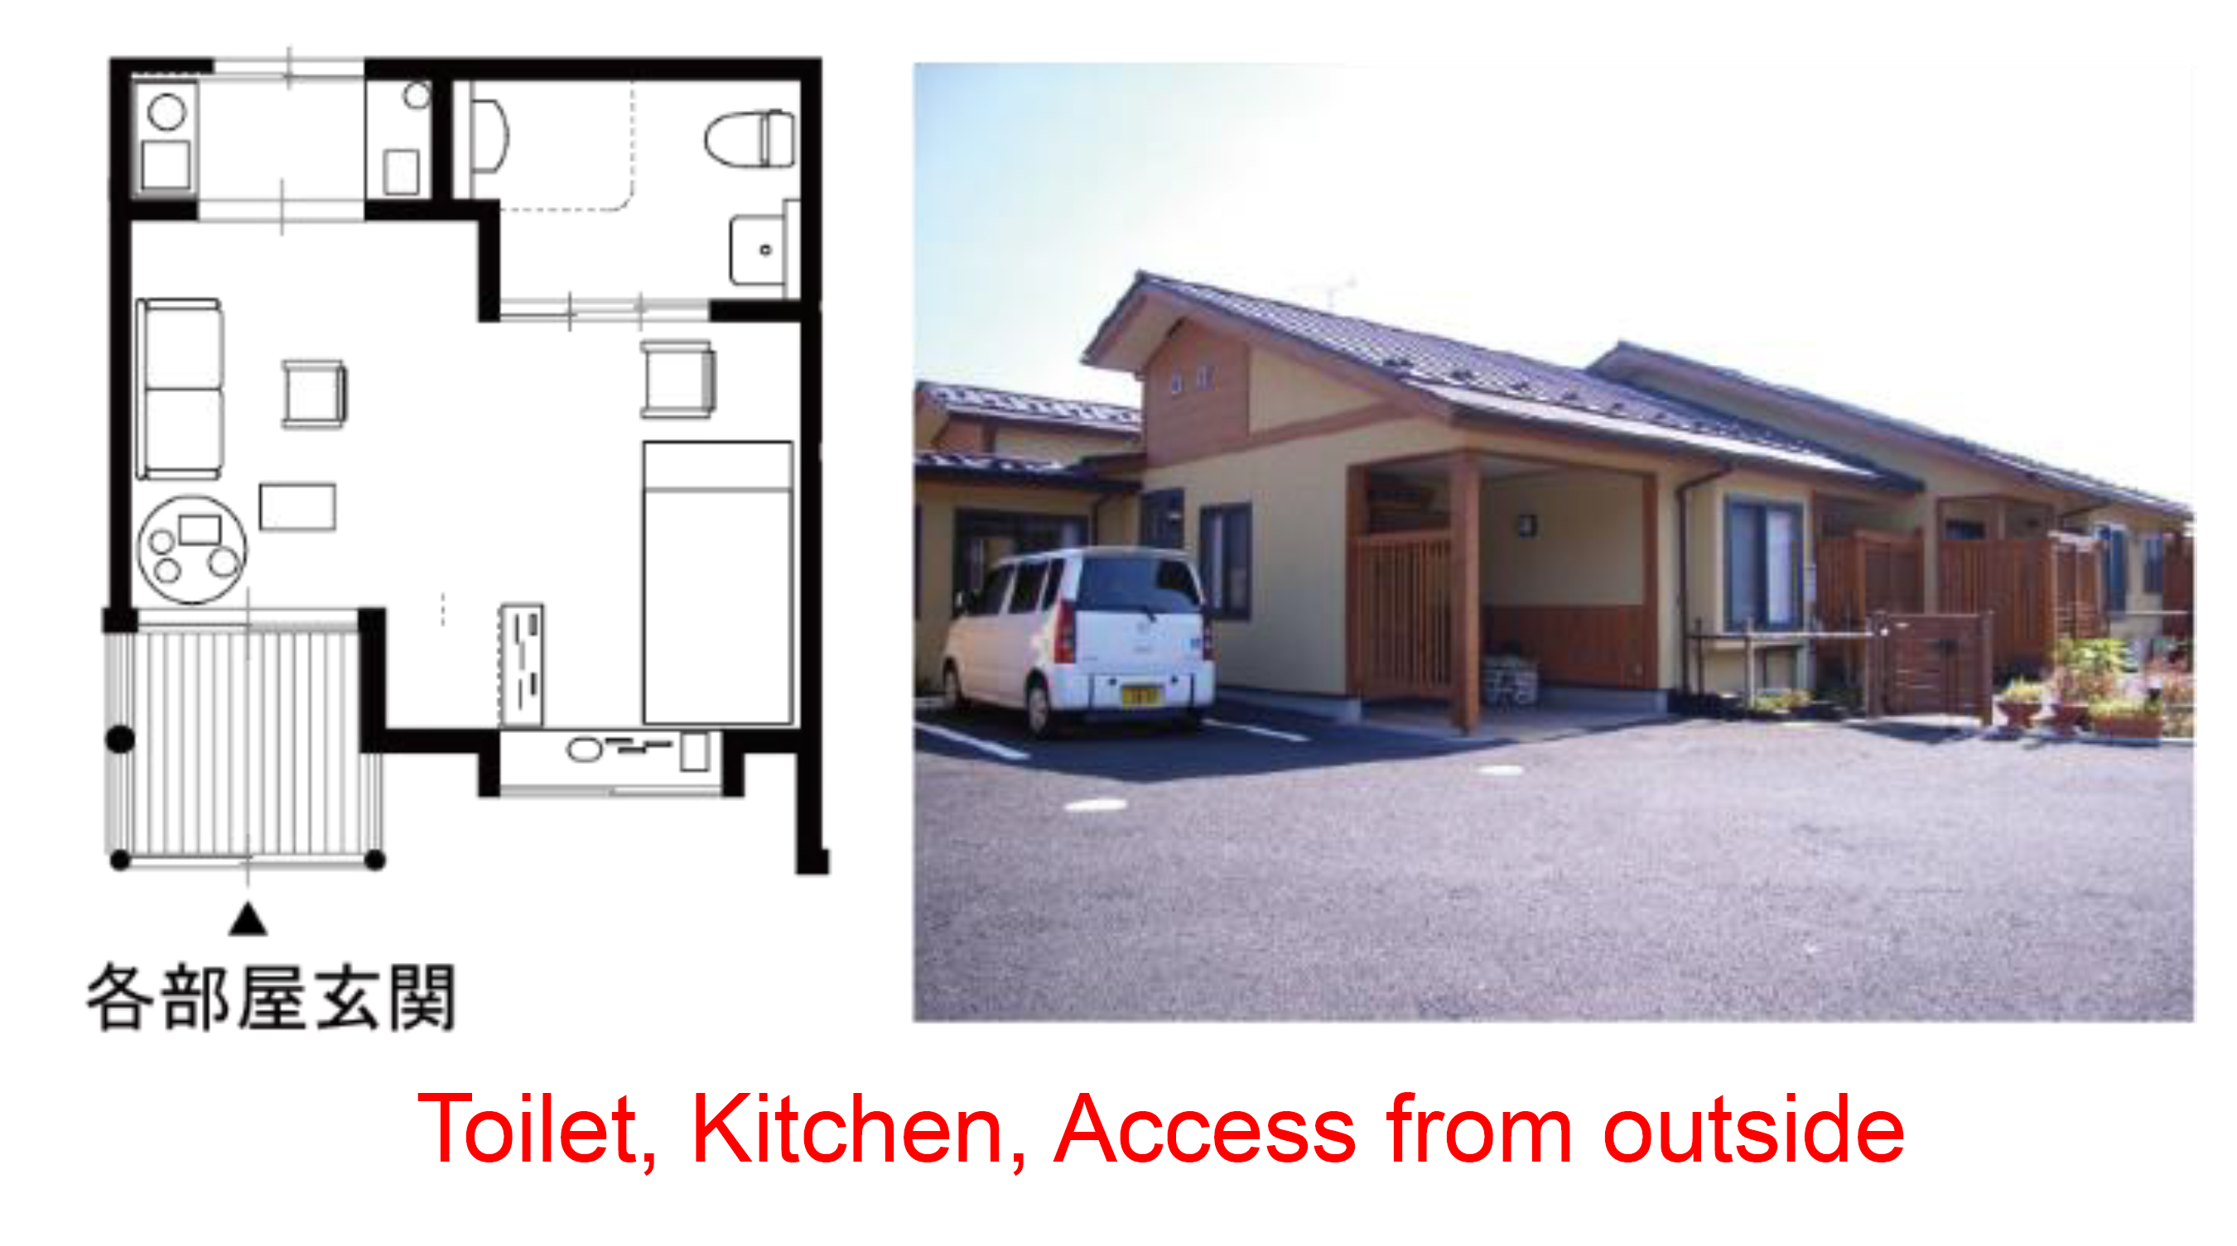
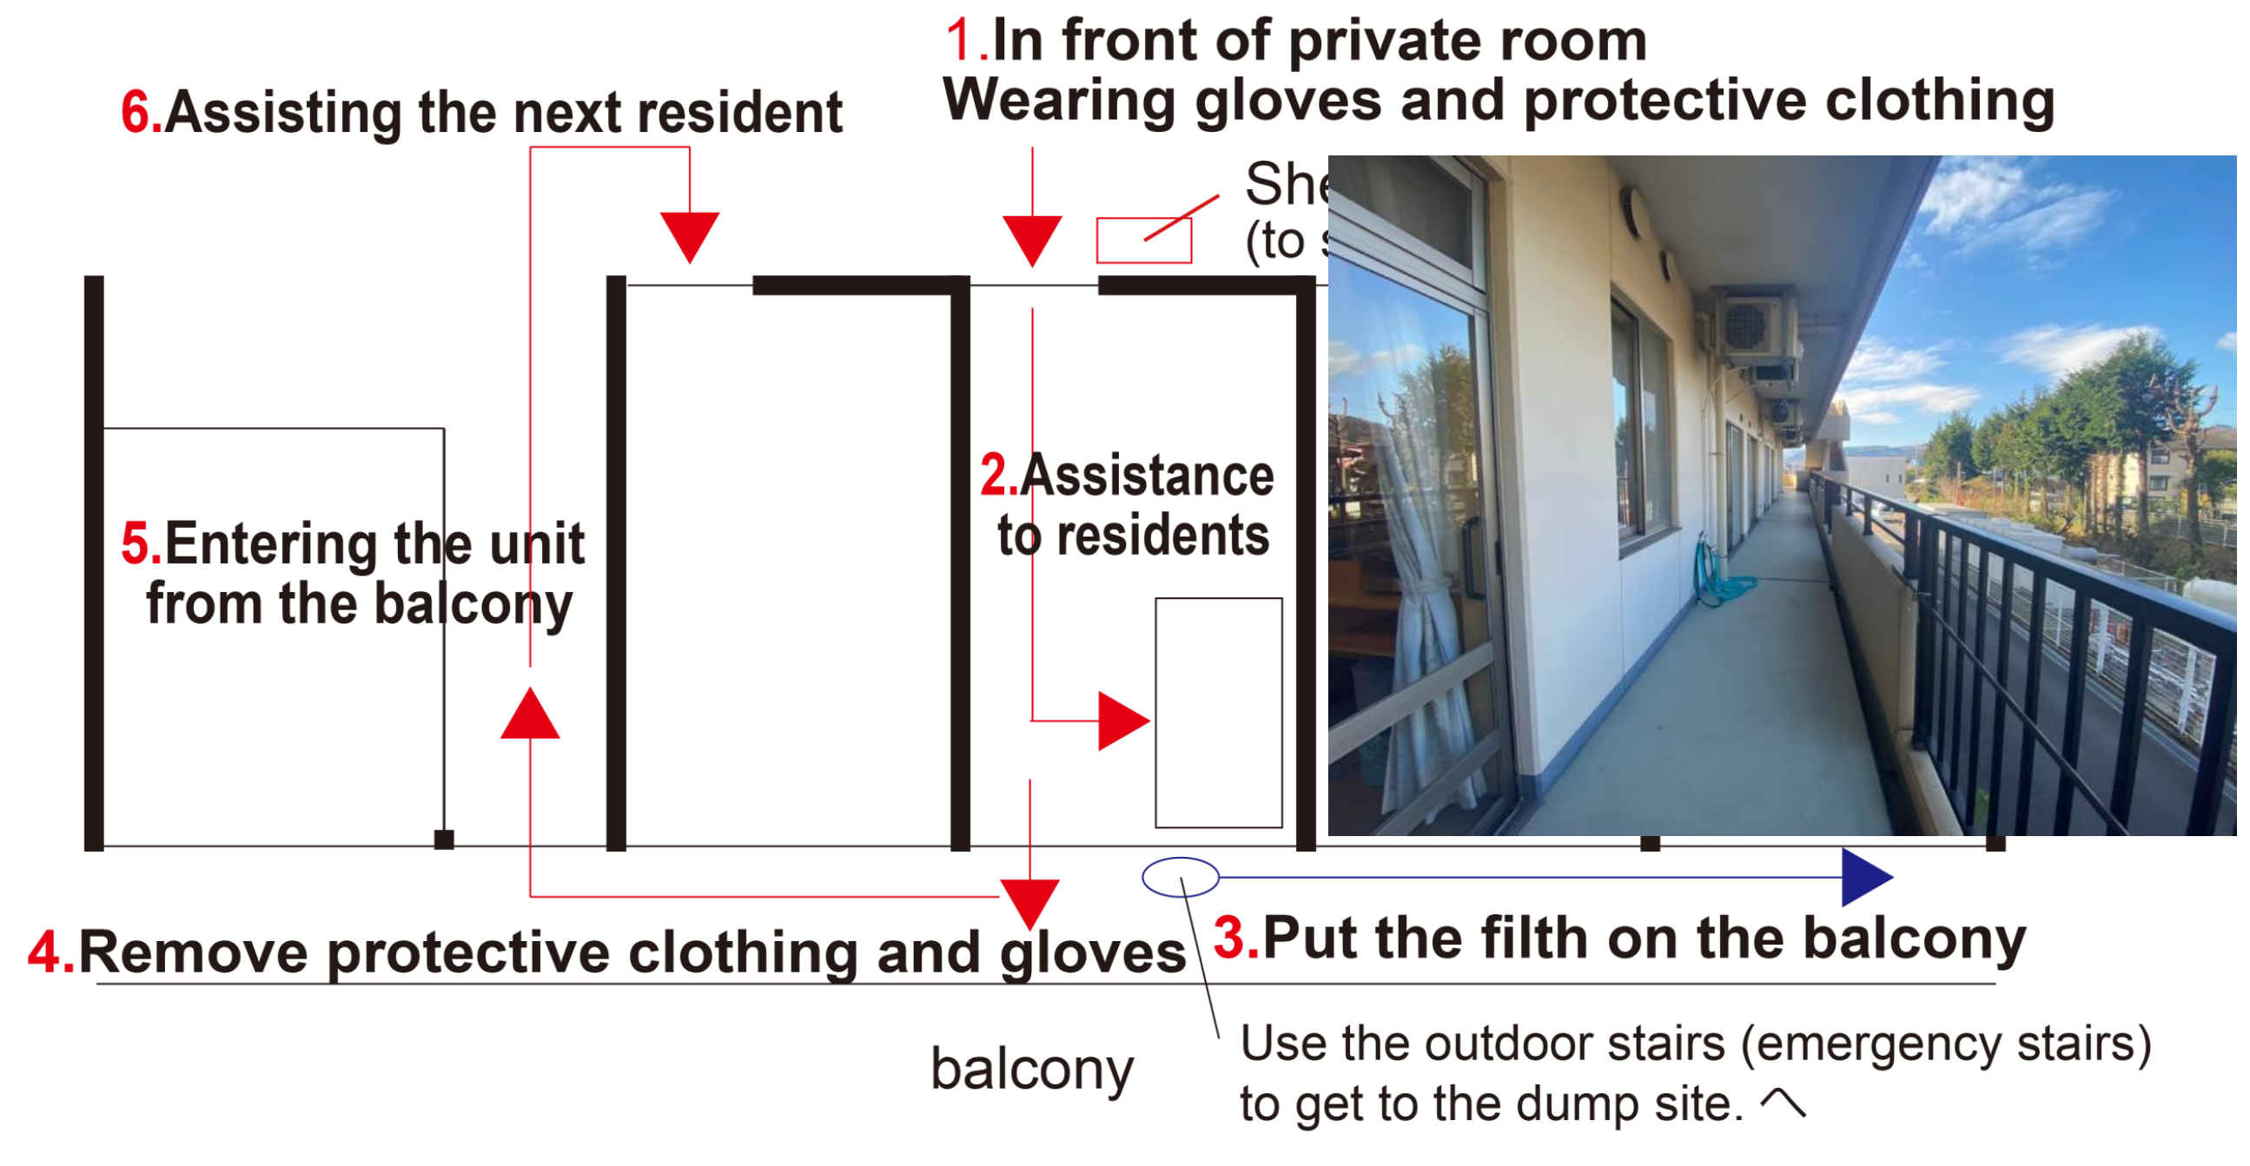
Buildings and facilities: developments in Japan

Slide 31
Conclusions

Slide 32
1. Stronger LTC systems
Contrasting the impact of climate change with the learning from Covid-19 highlights importance of addressing systemic vulnerability of LTC
Hopeful signs: the European Care Strategy, updated care plans in Japan, Korea, policy developments in China

Slide 33
2. Addressing ageism and ableism
Discourses that blame older people for climate change may impact their ability to take an active role
Equating people who draw on care with weakness may also exclude them from an active role in preparedness, response and recovery phases in emergencies

Slide 34
3. It is essential to recognise the LTC workforce
They need to play a key role in preparedness, response and recovery phase in emergencies
They need to be identified as key workers in emergencies
Addressing poor working conditions is essential to ensure that workforce shortages are not exacerbated in a crisis
Not so hopeful sign: almost all developed countries are experiencing severe workforce shortages

Slide 35
Finally,
In theory we had the pandemic to learn from, but have LTC systems actually internalised those lessons?

Slide 36
An Invitation:
The Global Observatory of Long-Term Care

Slide 37


Global Observatory of Long-Term Care www.GOLTC.org
A platform for cross-national learning to improve and strengthen care systems, part of the International Long-Term Care Policy Network.
To identify key shared challenges and showcase how different countries and localities are addressing them, share research evidence and facilitate collaborations.
For policymakers, industry, advocates, care professionals and academics.

Slide 38
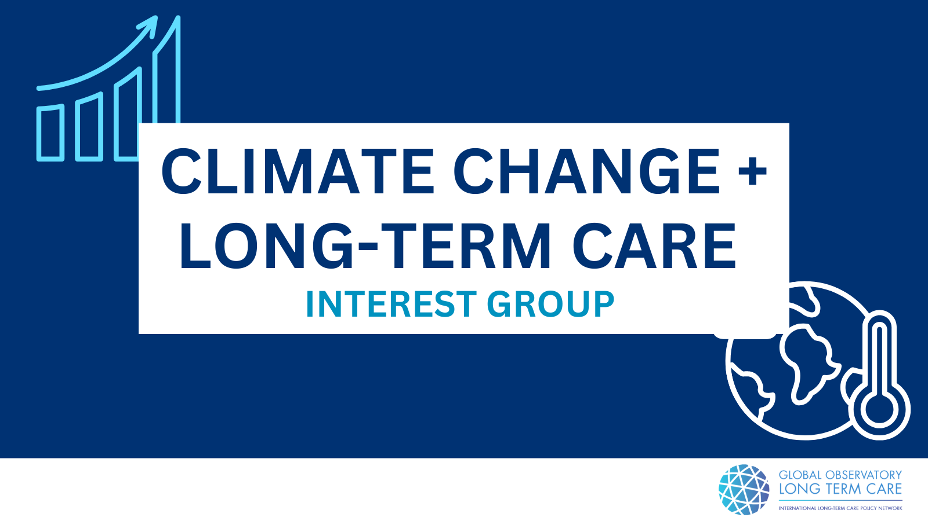

Slide 39
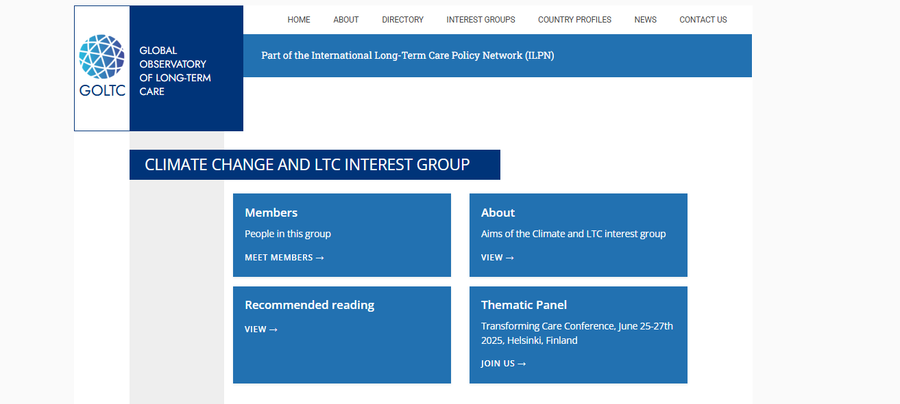
Let’s continue the conversation!
Join at https://goltc.org/add-new-expert/

Slide 40
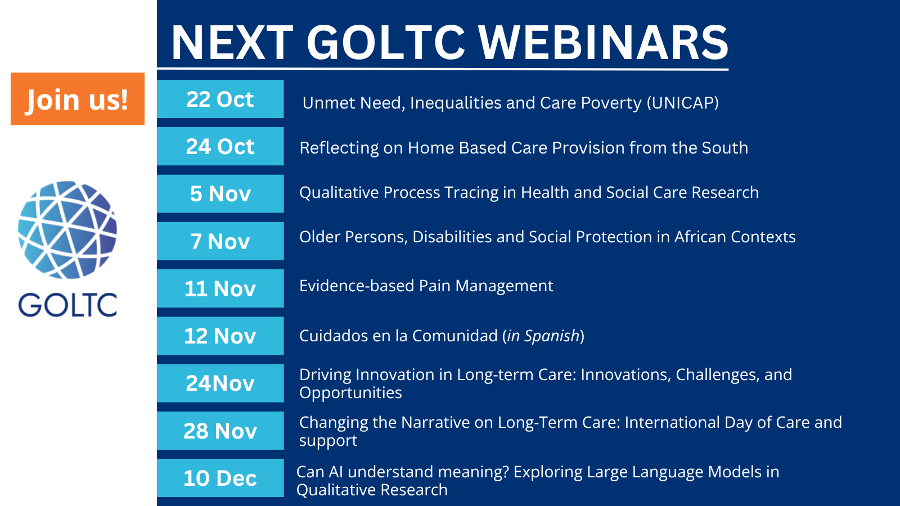
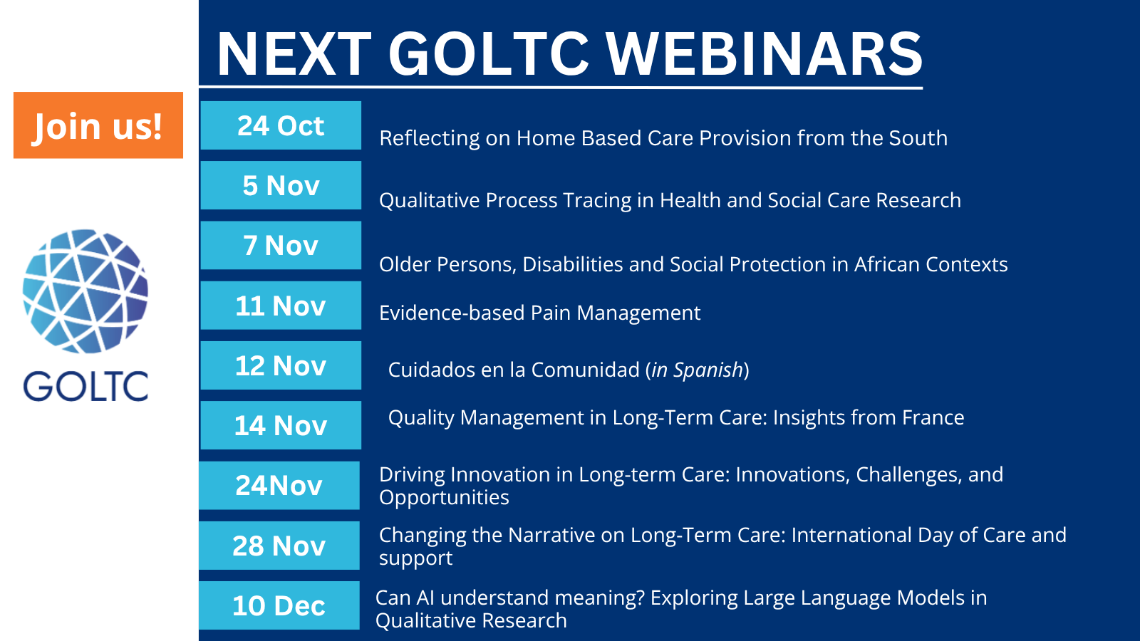

Slide 41


Slide 42



