Slide 1

Management in Medicine Programme
Launch of 2025/26 programme and accreditation process
Dr Nicholas Hicks
Chair of the Management in Medicine Steering Committee
with
Lisa Hoffart – Orthopaedic and Sport Physical Therapist, Calgary, Canada
Ellis Hall – Medical Student.

Slide 2

Management in Medicine Programme (MiM)
Initially developed in response to interest expressed by clinical students, medically qualified research students and medical alumni, as well as doctors in training posts (particularly Academic Clinical Fellows) in the Thames Valley.
It now attracts a much wider community both clinical/professional (including midwives, nurses and physiotherapists, social workers, GPs and consultants) and non-clinical (eg social scientists, MBA students, managers).
The programmes addresses elements of management, leadership, health systems and complexity.
The initiative draws on the deep tradition in medicine, health and the social sciences within Green Templeton, allied with its strength in business and management.

Slide 3
Management in Medicine Programme (MiM)
The purpose of the MiM Programme is to intervene at critical career stages to develop a strong general foundation in leadership and management which participants can then build on as their career progresses. This involves introduction and development of relevant:
Knowledge (e.g. understanding of the NHS, health policy, complex systems)
Skills (e.g. conflict management, influencing and leadership, programme and project management, effective decision making)
Attitudes (e.g. relationships between clinicians and managers, effective management and leadership)
…delivered through seminars, workshops and a shadowing programme.

Slide 4
Management in Medicine Programme (MiM)
Aims of the programme:
To give participants a variety of opportunities to learn about leadership and management in healthcare.
To help those working in health and care to understand the system they are working in, how to survive and thrive in it and how to influence its behavior.
To encourage participants and others make the most of the leadership and management elements of their roles as part of delivering a high quality service.
To bring together academics and practitioners interested in healthcare leadership and management.
To foster other teaching and research activities in this area at Green Templeton College.

Slide 5
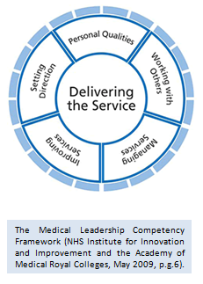
Management in Medicine Programme (MiM)
The MiM Programme was originally designed specifically using:
Medical Leadership Competency Framework
So
The programme addresses the Faculty of Medical Leadership and Management (FMLM) ‘Leadership and management standards for medical professionals’
Enables us to seek accreditation with FMLM
Each workshop, seminar and the shadowing programme generate credits that directly relate to the standards

Slide 6

Accreditation of MiM Programme
FMLM Leadership and Management Standards
“core values and behaviours designed to work across all career levels”
guided by the values espoused in the
  Seven Principles of Public Life (Nolan Principles) and the
  General Medical Council’s Good Medical Practice.

Slide 7
Faculty of Medical Leadership and Management
The ‘how’ and ‘what’ leaders do is set out as behaviours which can be observed, measured and developed:
    Self
        Self-awareness and self-development
        Personal resilience, drive and energy
    Team Player / Team Leader
        Effective teamwork
        Cross-team collaborations
    Corporate Responsibility
        Corporate team player
        Corporate culture, improvement and innovation
    System Leadership
        System leadership

Slide 8
Programme accreditation
Attendance at MiM events is open to anyone interested in the topics we cover, either single or multiple events. Those who want to follow a significant part of the programme can sign up to follow the accredited pathway and receive a certificate of completion of an FMLM accredited programme.
The programme was first accredited by FMLM in 2020 and also now earns 25 CPD credits.
Accreditation is based on credits earned by attendance at a balanced mixture of in-person sessions at Green Templeton and online sessions via Zoom and can be complemented with the shadowing programme.

Slide 9
Management in Medicine Accredited Programme
The MiM programme has been accredited by the Faculty of Medical Leadership and Management because is allows participants to meet their Leadership and Management Standards for Medical Professionals across the Self, Team, Corporate Responsibility and System Leadership domains.
Participants receive certification confirming they have attended an accredited programme by:
attending a balanced series of workshops, seminars and shadowing programme
submitting reflective pieces on overall impact, and plans to inform practice

Slide 10
Programme accreditation
If you would like to receive
a certificate of completion for the accredited programme,
you need to follow five steps

Slide 11

Participant certification
Register for each individual event that you plan to attend.
https://www.gtc.ox.ac.uk/academic/health-care/management-in-medicine/workshops/

Slide 12
Programme accreditation
Speaker self-assigned points against the Medical Leadership Competency Framework are mapped to FMLM Leadership and Management Standards for Medical Professionals.
These are moderated for each workshop and seminar to give overall credits for each behaviour.
NOTE: Programme accreditation is not assigned to individual sessions but the programme as a whole.

Slide 13
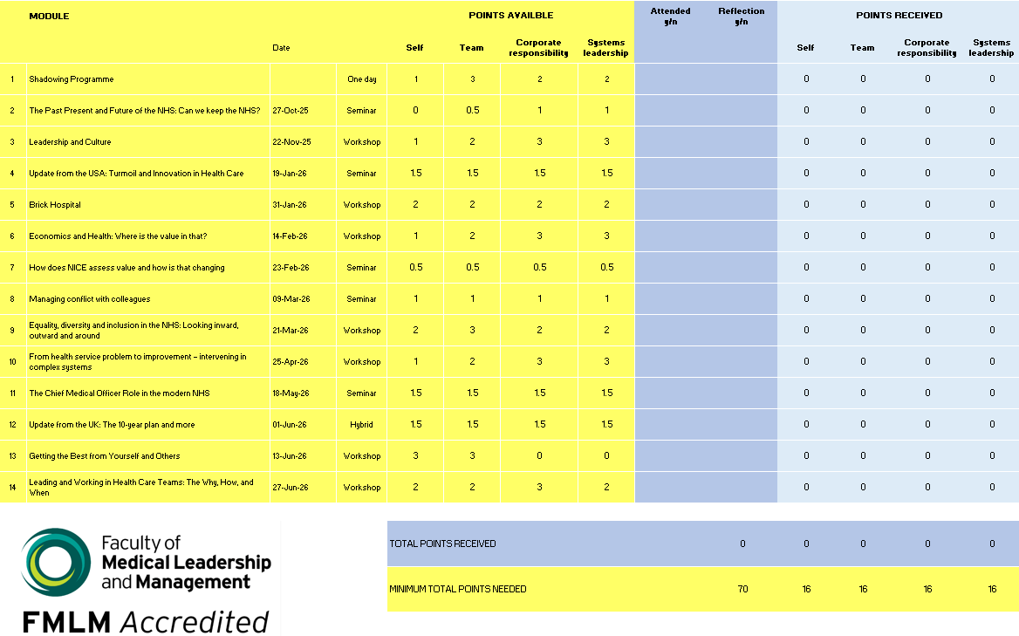
Participant certification
2. Attendance of a selection of seminars and workshops
Individuals record their attendance and associated credits via annual downloadable Attendance Tracker
Minimum of 16 credits in each domain (self, team, corporate, systems) and 70 credits in total are required
Complete the accredited pathway in one year by attending around 70% of the programme, alternatively completion can be over 2-3 years.

Slide 14
Participant certification
3. Participation in Shadowing Programme (optional)
  Launch Monday 20 October 2025
  Post placement survey and final report required.
Shadowing provides opportunities to ‘shadow’ NHS managers and others for short periods, typically two half-days.
The purpose of the shadowing is to give insight into the activities of managers, how they go about those activities, and the issues on which they work. Managers involved have included NHS Trust Chairs and Chief Executives, Medical Directors, and a Director of Social Services.
There are a limited number of places available. If you are interested in taking part in this year’s Shadowing Programme, you must attend the launch event, Monday, 20 October.

Slide 15
Participant certification
4. Reflections
  Write a short reflective piece for each event attended. Our recommendation is to write these as close to the event as possible.
  Write a final reflective piece on overall impact and plans to inform practice: what has been learned from the programme, how you might apply the learning in practice and what further actions you may take.
  Each reflective piece should be in the region of 400 words and submitted as one combined PDF.
  For guidance on good self-reflective learning: Please follow this link
https://www.fph.org.uk/professional-development/cpd/reflective-notes/

Slide 16
Participant certification
5. Submission
  Bi-annual submission dates: 1 March and 1 July
  Administration fee paid via an online system
    £25 submission fee – March 2026 (i.e. for those who started the programme prior to 2025/26)
    £75 submission fee – July 2026 onwards
    GTC students – submission free of charge
  Submission of self-reflective pieces for each session attended, plus a final overall reflection (each up to 400 words)
  Completed Attendance Tracker with a minimum of 70 credits
  Submissions approved and signed off by the Management in Medicine Steering Group
  Certificate issued

Slide 17
Management in Medicine Programme (MiM)
To help manage attendance of our Saturday Workshops, and ensure everyone has a fair chance to participate, we ask for a refundable deposit of £35 for in-person sessions.
✅ Your deposit is fully refundable – simply let us know via email to MiM@gtc.ox.ac.uk at least 24 hours before the workshop if you can no longer attend.
❌ Cancellations made within 24 hours of the start time of the workshop will not be eligible for a refund.
This system helps us reduce last-minute no-shows and make the best use of available spaces.
Alternatively, participants may choose to make a £35 non-refundable contribution towards the administration costs of the programme.
A platform fee (£1.22) will be added for each booking and is non-refundable.

Slide 18
Feedback from recent attendees
Overall, the programme has left me with a sense of optimism and excitement about my future career in the NHS. I started the programme believing that as clinicians, we had given up a relinquished a lot of control within our professional lives to managers and politicians. Now, I understand that we have the power and agency to drive change from a culture of competing priorities to one of collaboration, shared understanding and mutual appreciation through our leadership roles. In doing this, we can build a healthy workforce and provide the best patient care, allowing the NHS to survive and thrive for many more years.
Ultimately, the MiM programme has shifted my perspective from focusing solely on clinical excellence and patient care, to recognising the importance of care for the system in which we all work and rely. I aim not to be a surgeon delivering care, but a surgeon actively shaping the structures that determine whether care is accessible, equitable, and sustainable.
The MiM programme has been a great way of getting involved at this early stage in my career and has been extremely insightful into the impact I can make outside of clinical medicine.

Slide 19
Feedback from recent attendees
I am constantly looking for opportunities to maximize my Oxford student experience and one of my favorite opportunities has been the Management in Medicine program.
I was disappointed that I missed most of the workshops, but I attended as many seminars as I could
(sometimes more than once). I appreciated the knowledge depth of the presenters and how the
information changed from one year to the next with the increase in research data. I appreciate that
these seminars attract a diverse array of attendees from different lived experiences, and all were
encouraged to share and ask questions. These questions contributed to my understanding of each topic as a whole. Sometimes attendees challenged the presenter in respectful ways which demonstrated to me that there was never a singular final stance on issues in healthcare. Interactions with attendees were a demonstration of respectful dialogue, an experience that I cherish and that social media has replaced. I was grateful for the extra resources shared in the chat by other attendees. I thought that the sessions were very well moderated. Thank-you for this.

Slide 20
Previous participants
A few words on the MiM experience from participants of the programme in 2024-25:
Lisa Hoffart – Orthopaedic and Sport Physical Therapist, Calgary, Canada
Ellis Hall – Medical Student.

Slide 21
Questions
?
Naomi Benson and Walid Elbaz
MiM@gtc.ox.ac.uk

