Slide 1
From Dilnot to the dementia tax and beyond: why social care reform keeps going wrong

Slide 2


Simon Bottery
Senior Fellow, Social Care
Before joining The King’s Fund in 2017, Simon spent almost 10 years as Director of Policy at the older people’s charity Independent Age.
He has wide experience in policy, communications and journalism, including as Director of Communications at Citizens Advice. He has also worked for the charity ActionAid, in the commercial sector for Guinness and in BBC local radio.
He chairs the advisory board of the NIHR's School for Social Care Research.

Slide 3
This presentation will look at the history of adult social care reform over the past 15 years through the prism of public attitudes to social care.
It will show that public prioritisation of social care is typically low but punctuated by occasional peaks when government reform proposals bring the issue to greater attention.
It will show, however, that these occasions have tended to focus on the cost of reform and how money will be raised, and have ended badly for the governments concerned.
As a result, politicians have concluded that social care reform is a vote loser rather than a vote winner.
The presentation will propose ways in which the social care sector can break this logjam.

Slide 4
The paradox
People aren't satisfied with adult social care and want it to change
BUT
They don't prioritise it as an issue for government to tackle
AND
The debate we have is driven by costs not benefits

Slide 5
People don’t understand social care…

Slide 6
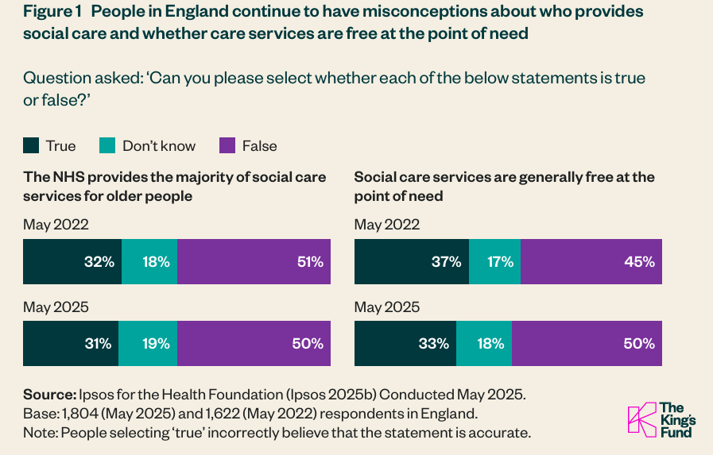
Many people still think social care is free

Slide 7

In fact, it is heavily means tested
£23,250

Slide 8

People think care is about vulnerable older people
In fact, half the cost is on working age adults

Slide 9
They say they aren’t happy with it…

Slide 10
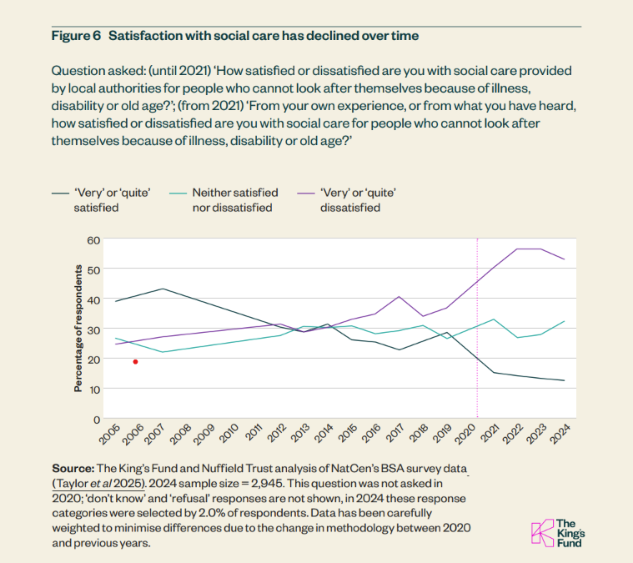

Public satisfaction with social care is at an all time low

Slide 11
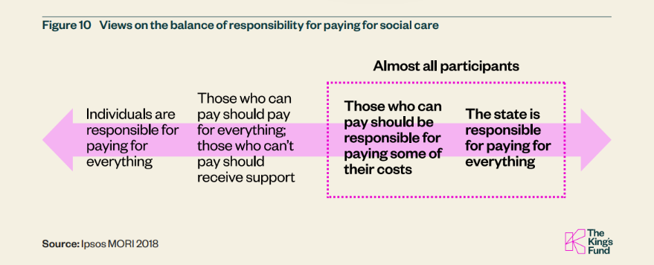
People want the state to take most responsibility for paying for social care

Slide 12
…but they don’t prioritise it as an issue

Slide 13

It's only top of mind for a handful of people in every 1,000

Slide 14
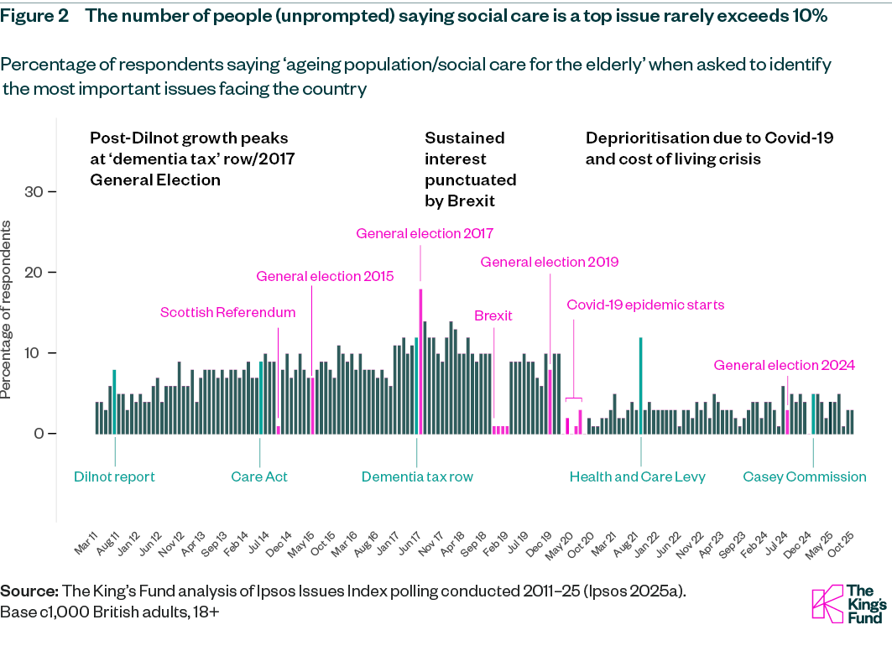
It has (small) peaks but it is easily forgotten when other issues arise
The bigger issues: NHS, economy, immigration

Slide 15
A history of adult social care in public attitudes

Slide 16
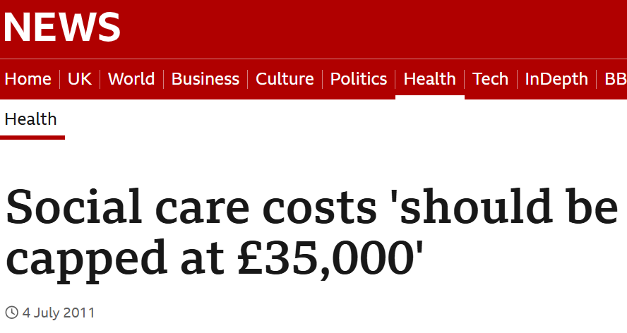

Slide 17
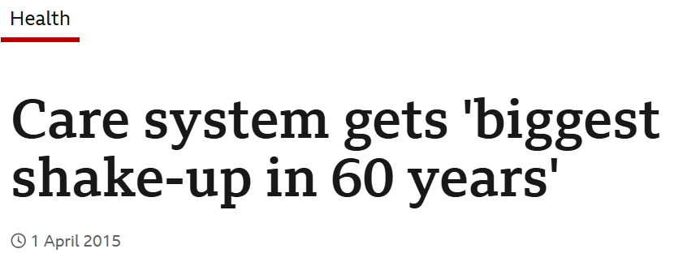

Slide 18
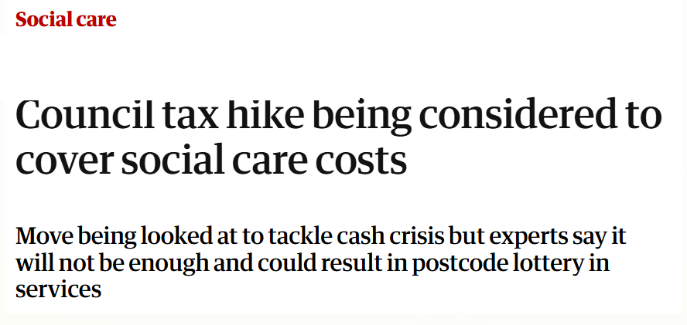

Slide 19
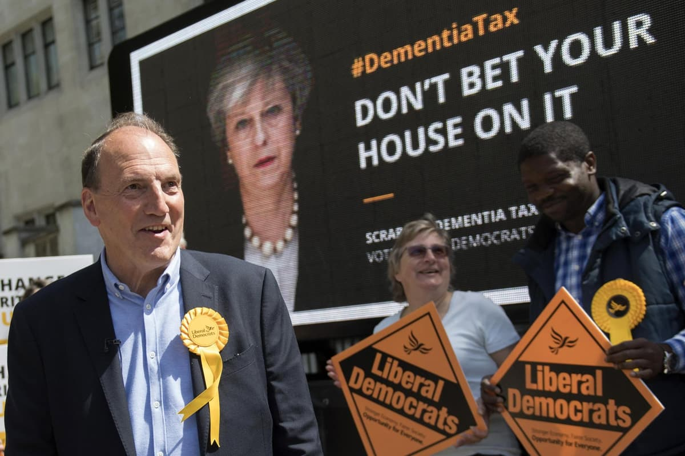

Slide 20
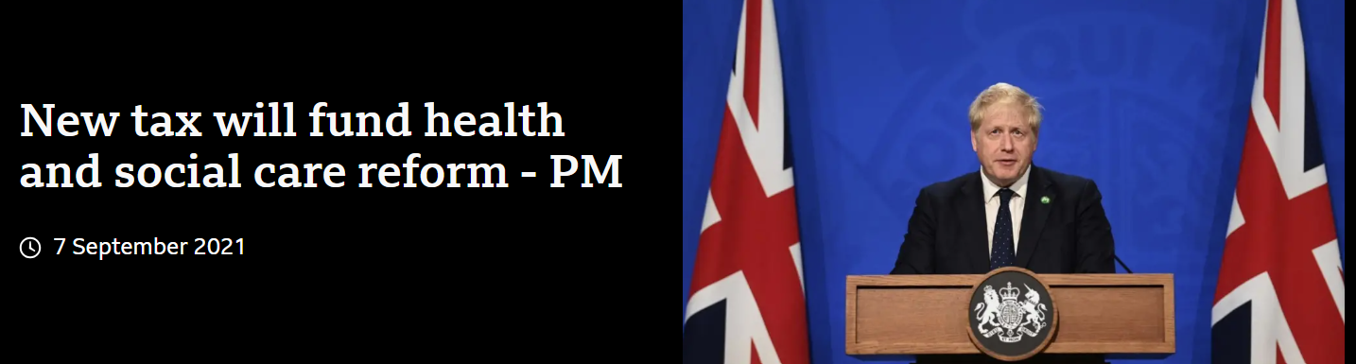

Slide 21
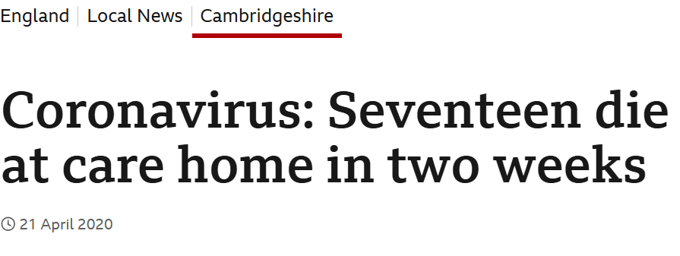

Slide 22
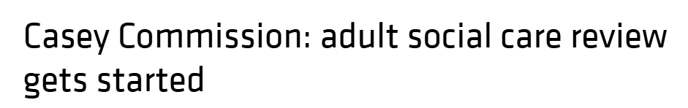

Slide 23
So what is going on…?

Slide 24
The state of public attitudes
Lack of understanding is hard to tackle because it is driven by: an unclear boundary between the NHS and social care; low usage of social care; the subject matter.
The outcomes, choices, control approach of the Care Act has passed people by
Third parties – the media, family and friends – are driving public views on satisfaction with social care
The history of social care reform may have led to people being fatalistic about change – and the sector may have contributed.
National political activity, rather than social care sector campaigning, drives public prioritisation of social care…
…but national political activity is usually focused on the most difficult and contentious subject – how social care should be funded

Slide 25
The debate is about ‘who pays?’

Slide 26
“General election campaigns are where plans for social care go to die.”
Former Secretary of State for Health and Social Care, Wes Streeting

Slide 27
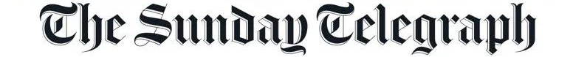
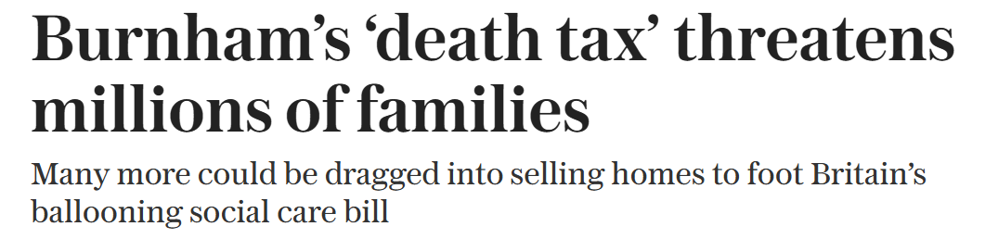

Slide 28
…and how might it change?

Slide 29
What can be done?
Clarify what motivates the ‘warm audience’ for social care
Reach people who influence attitudes to social care e.g. its workforce
Use the relationship between the NHS and social care
Accept that the public is in a different place
Identify the social care ‘tangibles’ that resonate
Seek to build political consensus
Don’t start by talking about the money
Identify what we still need to know e.g. what do people want money spent on?
Present a more consistent, credible case for reform

Slide 30
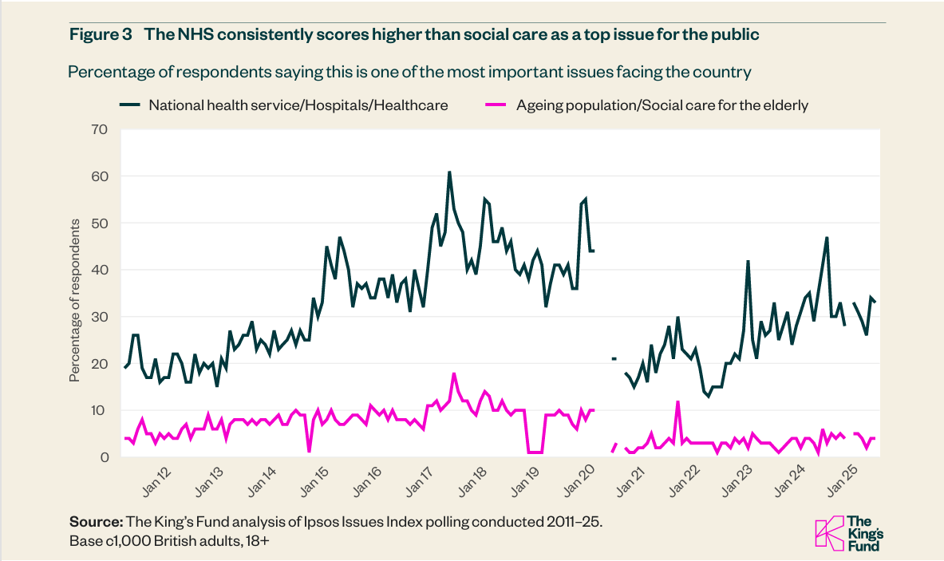
The NHS is much more of a policy priority than social care

Slide 31
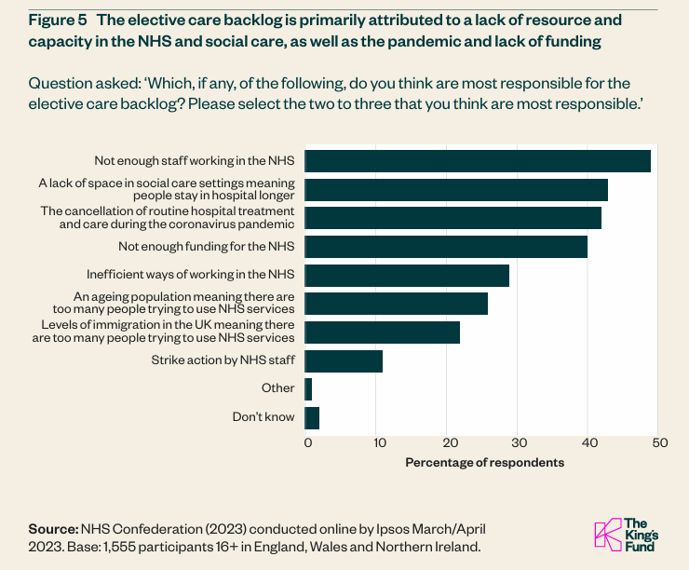
So linking to it may help…
“A lack of space in social care settings meaning people stay in hospital for longer”

Slide 32

‘More hospitals, more nurses’
‘What are the social care equivalents of these ‘tangibles’?

Slide 33
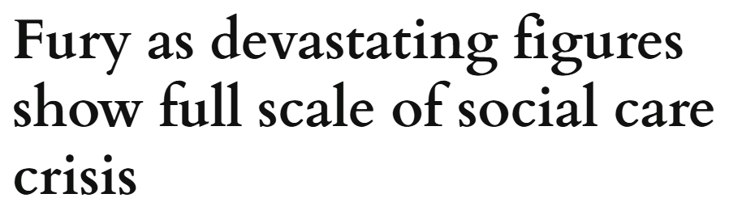
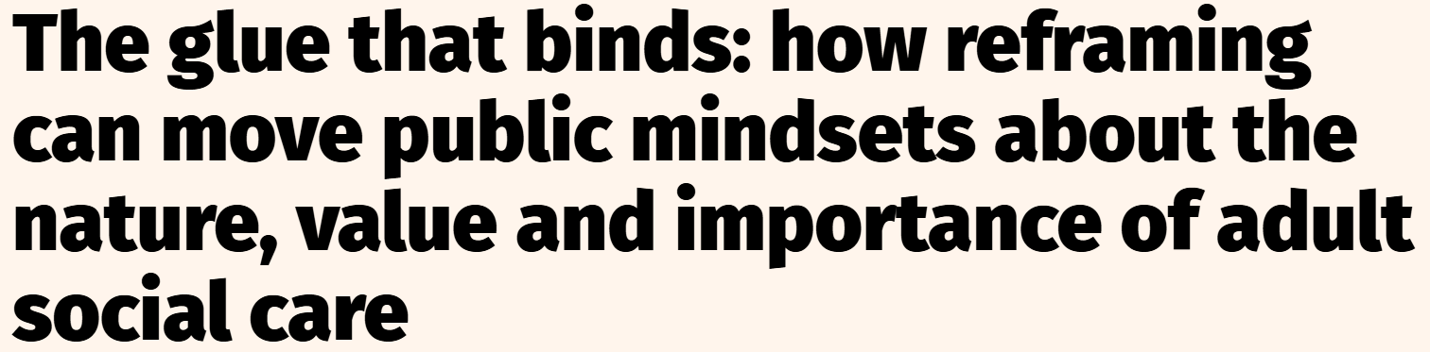
Beyond current narratives of ‘crisis’ and ‘glue’

Slide 34
For further information please see published report at
Not My Priority: How The Public Sees Social Care (And What Can Be Done About It) | The King's Fund
Or contact: s.bottery@kingsfund.org.uk and d.wellings@kingsfund.org.uk

