Slide 1

Management in Medicine (MiM)
shaping healthcare
Programme launch and accreditation process 2026/27
Dr Nicholas Hicks
Chair of Management in Medicine Steering Committee

Slide 2

Management in Medicine (MiM)
Initially developed in response to interest expressed by clinical students, medically qualified research students and medical alumni, as well as doctors in training posts (particularly Academic Clinical Fellows) in the Thames Valley.
It now attracts a much wider community both clinical/professional (including midwives, nurses and physiotherapists, social workers, GPs and consultants) and non-clinical (eg social scientists, MBA students, managers).
The programmes addresses elements of management, leadership, health systems and complexity.
The initiative draws on the deep tradition in medicine, health and the social sciences within Green Templeton, allied with its strength in business and management.

Slide 3
Management in Medicine (MiM)
The purpose of the MiM at GTC, Shaping Healthcare Programme is to intervene at critical career stages to develop a strong general foundation in leadership and management which participants can then build on as their career progresses. This involves introduction and development of relevant:
Knowledge (e.g. understanding of the NHS, health policy, complex systems)
Skills (e.g. conflict management, influencing and leadership, programme and project management, effective decision making)
Attitudes (e.g. relationships between clinicians and managers, effective management and leadership)
…delivered through seminars, workshops and a shadowing programme.

Slide 4
Management in Medicine (MiM)
Aims of the programme:
To give participants a variety of opportunities to learn about leadership and management in healthcare.
To help those working in health and care to understand the system they are working in, how to survive and thrive in it and how to influence its behavior.
To encourage participants and others make the most of the leadership and management elements of their roles as part of delivering a high quality service.
To bring together academics and practitioners interested in healthcare leadership and management.
To foster other teaching and research activities in this area at Green Templeton College.

Slide 5
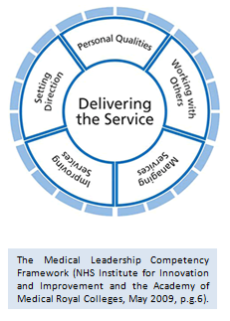
Management in Medicine (MiM)
The Management in Medicine Programme was originally designed specifically using:
Medical Leadership Competency Framework
So
The programme addresses the Faculty of Medical Leadership and Management (FMLM) ‘Leadership and management standards for medical professionals’
Enables us to seek accreditation with FMLM
Each workshop, seminar and the shadowing programme generate credits that directly relate to the standards

Slide 6

Accreditation of Management in Medicine programme
FMLM Leadership and Management Standards
“core values and behaviours designed to work across all career levels”
guided by the values espoused in the
  Seven Principles of Public Life (Nolan Principles) and the
  General Medical Council’s Good Medical Practice.

Slide 7
Faculty of Medical Leadership and Management
The ‘how’ and ‘what’ leaders do is set out as behaviours which can be observed, measured and developed:
    Self
        Self-awareness and self-development
        Personal resilience, drive and energy
    Team Player / Team Leader
        Effective teamwork
        Cross-team collaborations
    Corporate Responsibility
        Corporate team player
        Corporate culture, improvement and innovation
    System Leadership
        System leadership

Slide 8
Programme accreditation
The Management in Medicine programme is open to anyone interested in the topics we cover, either single or multiple events. Those who want to follow a significant part of the programme can sign up to follow the accredited pathway and receive a certificate of completion of an FMLM accredited programme.
The programme was first accredited by FMLM in 2020 and also now earns 25 CPD credits.
Accreditation is based on credits earned by attendance at a balanced mixture of in-person sessions at Green Templeton and online sessions via Zoom and can be complemented with the shadowing programme.

Slide 9
Management in Medicine (MiM) Accredited Programme
The Management in Medicince programme has been accredited by the Faculty of Medical Leadership and Management because is allows participants to meet their Leadership and Management Standards for Medical Professionals across the Self, Team, Corporate Responsibility and System Leadership domains.
Participants receive certification confirming they have attended an accredited programme by:
attending a balanced series of workshops, seminars and shadowing programme
submitting reflective pieces on overall impact, and plans to inform practice

Slide 10
Programme accreditation
If you would like to receive
a certificate of completion for the accredited programme,
you need to follow five steps

Slide 11
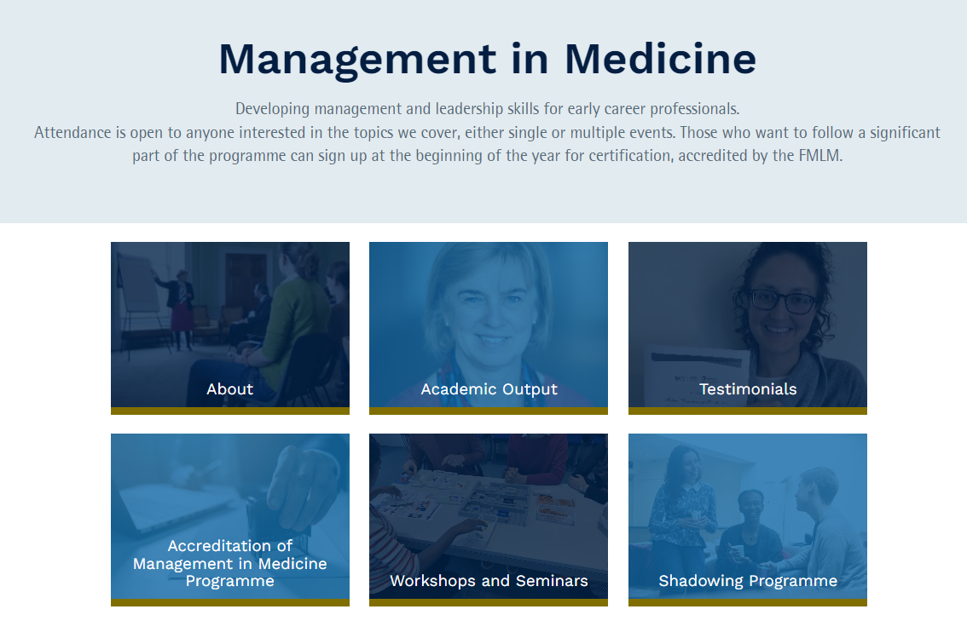
Participant certification
Register for each individual event that you plan to attend.
https://www.gtc.ox.ac.uk/academic/health-care/management-in-medicine/workshops/

Slide 12
Programme accreditation
Speaker self-assigned points against the Medical Leadership Competency Framework are mapped to FMLM Leadership and Management Standards for Medical Professionals.
These are allocated for each workshop and seminar to give overall credits for each behaviour.
NOTE: Programme accreditation is not assigned to individual sessions but the programme as a whole.

Slide 13
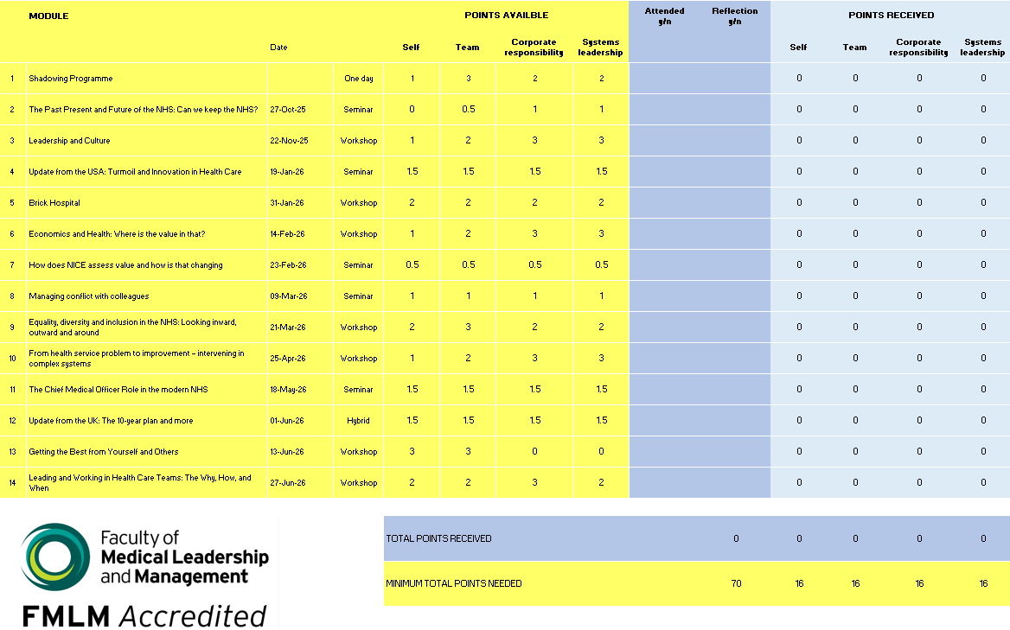
Participant certification
2. Attendance of a selection of seminars and workshops
Individuals record their attendance and associated credits via annual downloadable Attendance Tracker
Minimum of 16 credits in each domain (self, team, corporate, systems) and 70 credits in total are required
Complete the accredited pathway in one year by attending around 70% of the programme, alternatively completion can be over 2-3 years.

Slide 14
Participant certification
3. Participation in Shadowing Programme (optional)
  Launch Monday 26 October 2026
  Post placement survey and final report required.
Shadowing provides opportunities to ‘shadow’ NHS managers and others for short periods, typically two half-days.
The purpose of the shadowing is to give insight into the activities of managers, how they go about those activities, and the issues on which they work. Managers involved have included NHS Trust Chairs and Chief Executives, Medical Directors, and a Director of Social Services.
There are a limited number of places available. If you are interested in taking part in this year’s Shadowing Programme, you must attend the launch event on Monday, 26 October.

Slide 15
Participant certification
4. Reflections
  Write a short reflective piece for each event attended. Our recommendation is to write these as close to the event as possible.
  Write a final reflective piece on overall impact and plans to inform practice: what has been learned from the programme, how you might apply the learning in practice and what further actions you may take.
  Each reflective piece should be in the region of 400 words and submitted as one combined PDF.
  For guidance on good self-reflective learning: Please follow this link
https://www.fph.org.uk/professional-development/cpd/reflective-notes/

Slide 16
Participant certification
5. Submission
  Bi-annual submission dates: 1 March and 1 July
  Administration fee paid via an online system
    £75 submission fee
    GTC students – submission free of charge
  Submission of self-reflective pieces for each session attended, plus a final overall reflection (each up to 400 words)
  Completed Attendance Tracker with a minimum of 70 credits
  Submissions approved and signed off by the Management in Medicine Steering Group
  Certificate issued

Slide 17
Management in Medicine (MiM)
To help manage attendance of our Saturday Workshops, and ensure everyone has a fair chance to participate, we ask for a refundable deposit of £35 for in-person sessions.
✅ Cancellations made by emailing MiM@gtc.ox.ac.uk more than 48 hours before the start time of the workshop are fully refundable.
❌ Cancellations made within 48 hours of the start time of the workshop will not be eligible for a refund.
This system helps us reduce last-minute no-shows and make the best use of available spaces.
Alternatively, participants may choose to make a £35 non-refundable contribution towards the administration costs of the programme.
A platform fee (£1.22) will be added for each booking and is non-refundable.

Slide 18
Feedback from recent attendees
I am very grateful to have had the opportunity to take part in this programme. I embarked on it
having only experienced the clinical aspect of medicine. The programme has helped me broaden my
view of what goes on ‘behind the scenes’ ranging from leadership and value assessment to AI and
future planning. I also now better understand what I can do as a doctor that goes beyond the
standard job description.
Participating in the Management in Medicine (MiM) Programme at Green Templeton College has fundamentally broadened my understanding of leadership, moving it beyond the traditional perception of authority and decision-making towards a deeper appreciation of relationships, system thinking, and self-awareness. As a clinician, I have always focused on delivering high-quality patient care, but this programme demonstrated that improving healthcare outcomes for our patients, our first concern, also requires clinicians to understand organisations, influence change, maintain agency and lead across professional boundaries.

Slide 19
Feedback from recent attendees
I have gained unique insights into healthcare leadership, deepening my understanding of systems, culture and effective teamwork. Exploring self-awareness, corporate culture and system leadership has reinforced my ability to influence high-quality care. Expert speakers and diverse participant perspectives have refined my thinking and advanced key leadership and management concepts.
I have found this programme to be incredibly insightful and successful in its aim to
help us develop a broader understanding of healthcare that extends beyond individual
clinical encounters to encompass leadership, health systems, economics, quality
improvement and population health.
Following the Management in Medicine Programme has offered me a glimpse into two possible healthcare futures. In one future, technology and innovative models of care delivery have been harnessed to accomplish the three shifts and deliver equitable, personalised healthcare that proactively promotes health as well as treating disease. Meanwhile, doctors and allied health professionals have reclaimed the relational aspect of their practice and embraced their wider role in protecting and promoting the health of whole communities.

Slide 20
Questions
?
Naomi Benson and Ruth Holliday
MiM@gtc.ox.ac.uk

